Slide 1
Produce API .Net Core

Slide 2
TodoList
Create Interface
1
Create Repository
2
Create Controller
3
Test the API
4

Slide 3
Create Interface
Right click on your project name
Click add new folder, name with Repository
Inside the Repository folder, add another folder name with Interface
Inside the Interface folder, add new item. Choose the interface file, name with IPersonRepository

Slide 4
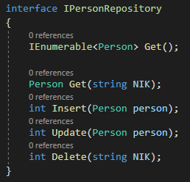
Type this code.

Slide 5
Quiz
Anyone know why the type is different?
Anyone know why we use IEnumerable rather than IList?
Anyone know why we return model on second method?
Anyone know why we return int for the rest of the method?
Anyone know what is the function of interface?

Slide 6
Create Repository
Back to repository folder, add a new class name with PersonRepository.
Implement the IPersonRepository.

Slide 7
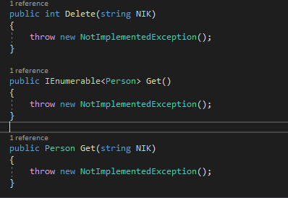
If you do it correctly, there will be code like this appear inside your class.

Slide 8
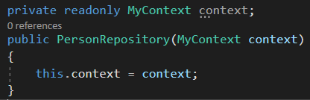
Add constructor

Slide 9

We’re going to add database logic in Repository file.
We use a feature named EntityFramework (EF). EF is an ORM that use as a gateway to database.
The basic database are CRUD, so here is the list of command in EF to query data for CRUD function.
Create = .Add()
Read = .ToList()
Update = EntityStateModified
Delete = .Remove()
Anything after query data, we have to save the data using .SaveChanges()

Slide 10
Here’s the code look like

Slide 11
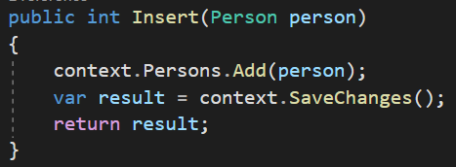
Create

Slide 12
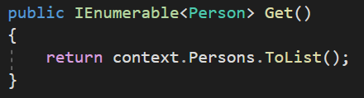
Read

Slide 13
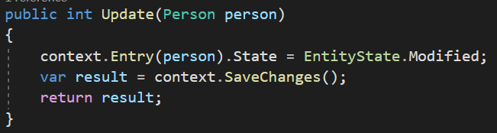
Update

Slide 14
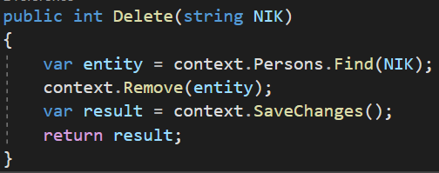
Delete

Slide 15
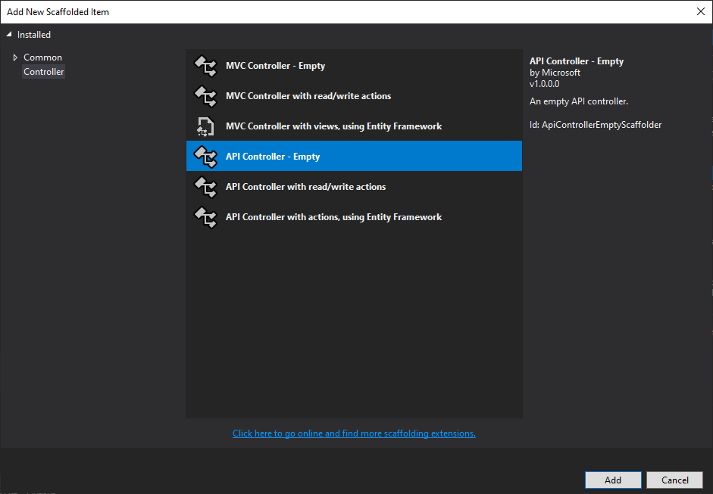
Create Controller
Inside the controller folder, add an API controller file name with PersonsController.

Slide 16
Inside the controller, we will control the logic in repository to represent the result on what method we execute.
Don’t forget to add constructor from Repository file

Slide 17
We’re going to use HTTPMethod to control the data.
This is the kind of HTTPMethod:
GET
POST
PUT
PATCH
DELETE

Slide 18
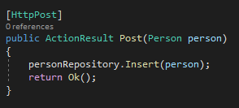
Add code like this inside the controller. So is for another method

Slide 19
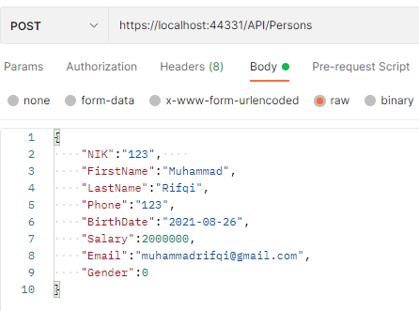
To test the API, use Postman.
Add request to insert data, adjust the method and URL. Insert data from body tab.

Slide 20
While we test to post data using postman, there will be error like this
System.InvalidOperationException: Unable to resolve service for type 'API.Repository.PersonRepository' while attempting to activate 'API.Controllers.PersonsController'.

Slide 21
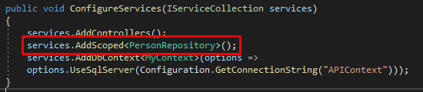
Open startup.cs

Slide 22
So, here’s the naming convention rules that we used
Model = The Table’s Name (PascalCase)
Example = Person
Interface = I + Table’s Name + Repository (PascalCase)
Example = IPersonRepository
Repository = Table’s Name + Repository (PascalCase)
Example = PersonRepository
Controller = Table’sName+S/Es+Controller (PascalCase)
Example = PersonsController

Slide 23

Reference
ActionResult => https://www.tutorialsteacher.com/webapi/action-method-return-type-in-web-api
Route => https://docs.microsoft.com/en-us/aspnet/web-api/overview/web-api-routing-and-actions/attribute-routing-in-web-api-2

